Slide 1
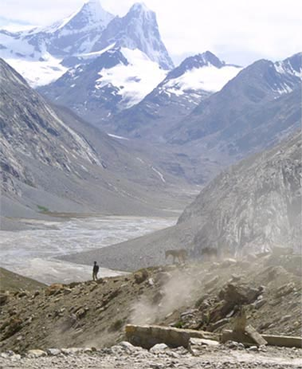
Fellowship of the Heart
Getting Started — the Four Connects, walked around the table on alternating evenings
Evening Series 2026–27 · at the Tittle home · v1.5E DRAFT
All Scripture: ESV · The Companion lesson plans carry the full scripts — these slides carry the room
1
Notes:
DECK TITLE · pre-session · DIVIDER
On screen as the room assembles on night one. All Scripture ESV; the plans carry the scripts; these slides carry the room — and these notes carry you.

Slide 2
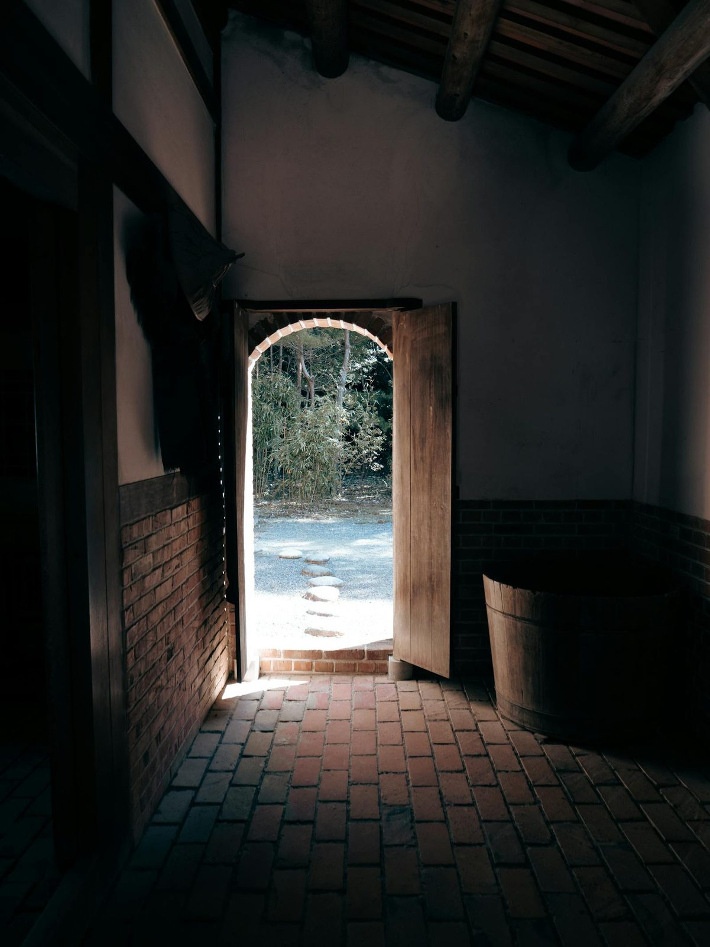
SESSION 1
Welcome to the Journey
Establishing the container; introducing the four Connects
Quarter 1: Connect with Self & Others
3
Notes:
S1 · pre-session · DIVIDER
On screen through dinner and as the circle forms. Greet at the door — the slide holds the room.

Slide 3
Session 1 — Tonight’s Road
1 Welcome — the very-first-time orientation
2 The door out — one name, said once
3 The Four Connects — kitchen-table teaching
4 Container introduction — the first full protocol
5 One True Sentence — why each of us is here
6 Scripture: John 10:10 — and the seed, stated plainly
7 What does it mean to be saved?
8 Homework commissioning — handout + check-in partners
9 The Leader Feedback Round (debut) — both leaders
10 Closing container + Aaronic blessing
THIS YEAR, IN ONE LINE
Hearing and obeying God
Two leads tonight — handing the evening back and forth
4
Notes:
S1 · 7:00–8:30 · BOTH LEADERS
BEATS:
1. Thirty-second walk of the night: welcome, Four Connects, first container, One True Sentence, John 10:10, the saved question, practice, close.
2. Start on time at 7:00. Whole night is one shared circle — family clusters begin Week 2.
3. Timing trap: the teaching is always cuttable; the experiential blocks are not.
CUES: Chairs in one circle, no table; Four Connects diagram pre-drawn on the whiteboard; leader sits in the circle, not at the head.

Slide 4
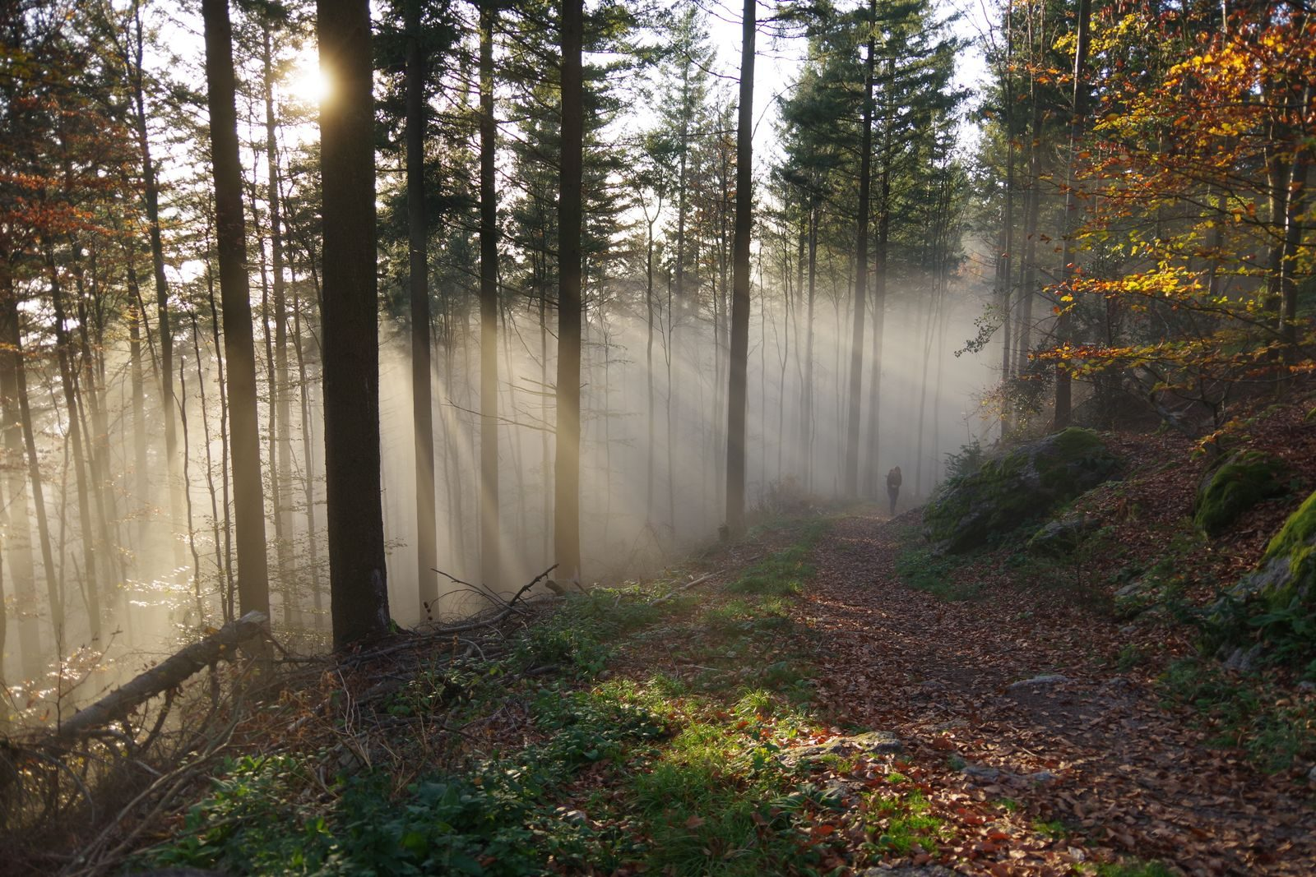
Welcome — the Very-First-Time Orientation
• “I came that they may have life and have it abundantly.” — John 10:10
• This is a journey of exploration
– Your heart
– This process — the plans, practices, and pages live at the Fellowship of the Heart website
– This group
• This is not a youth group
• It is family formation and growth in Christ
• An offer of leadership opportunity
5
Notes:
S1 · 7:00–7:08 · LEAD: CONTAINER HOLDER
BEATS:
1. Stand at the open of the circle; wait for full silence before a word.
2. Three things: today is the doorway, not the destination; no chaperones — every person is a participant; phones silenced and away (the ask is enough — no collecting, no policing).
3. Around 7:05 shift to what-this-is framing: real interior work as families; not a Bible study, not youth group, not therapy — an invitation to the abundant life of John 10:10.
CUES: A parent sliding into chaperone mode gets 'Today we are all participants. Let me hold the space.'

Slide 5
One More Person You Should Know About
• Pastor Bobby Gore · (831) 277-9878 — not part of our team
• If something ever needs saying that you would rather not say to me, or to your Companion, or to your parents, you can go straight to him
• No reason needed, no permission needed, and nobody here will be told. It is on the page you take home tonight
6

Slide 6
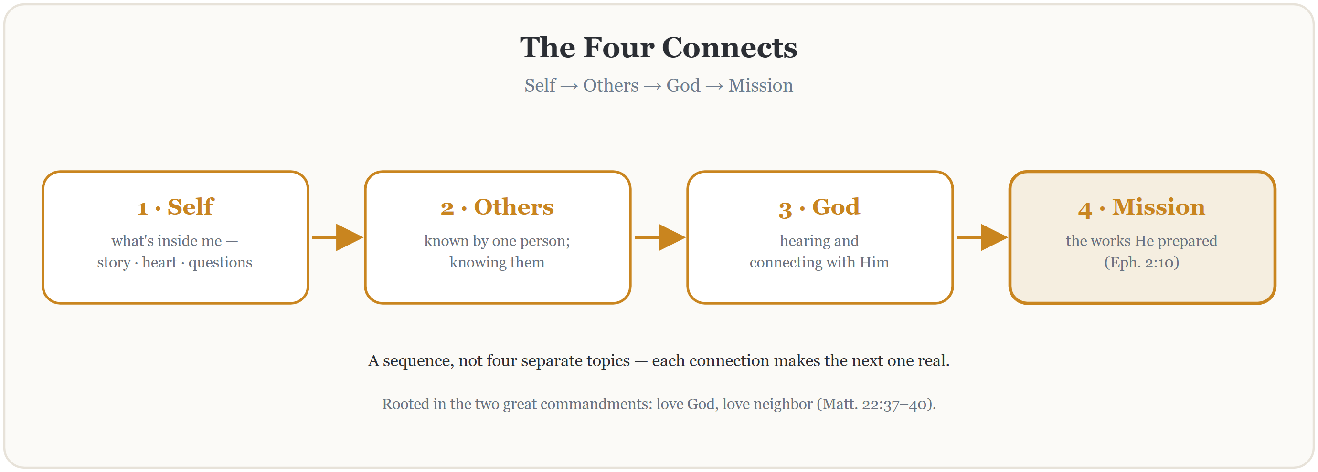
The Four Connects
THE TWO GREAT COMMANDMENTS: Matthew 22:37–40 — love God · love your neighbor
7
Notes:
S1 · 7:08–7:20 · LEAD: CONTENT PRESENTER
BEATS:
1. Stand at the whiteboard; diagram already drawn. Matthew 22 origin: two commandments, four connections.
2. Walk the sequence: Self, then Others, then God, then Mission — a sequence, not four separate topics.
3. Sketch the year's map, then release it: 'Don't worry about memorizing it. These twenty-two weeks will teach it to you.'
GUARD: Ten minutes maximum — do not teach the whole framework today. Concrete language for teens: 'the person at your lunch table knowing what's actually going on inside you.'

Slide 7
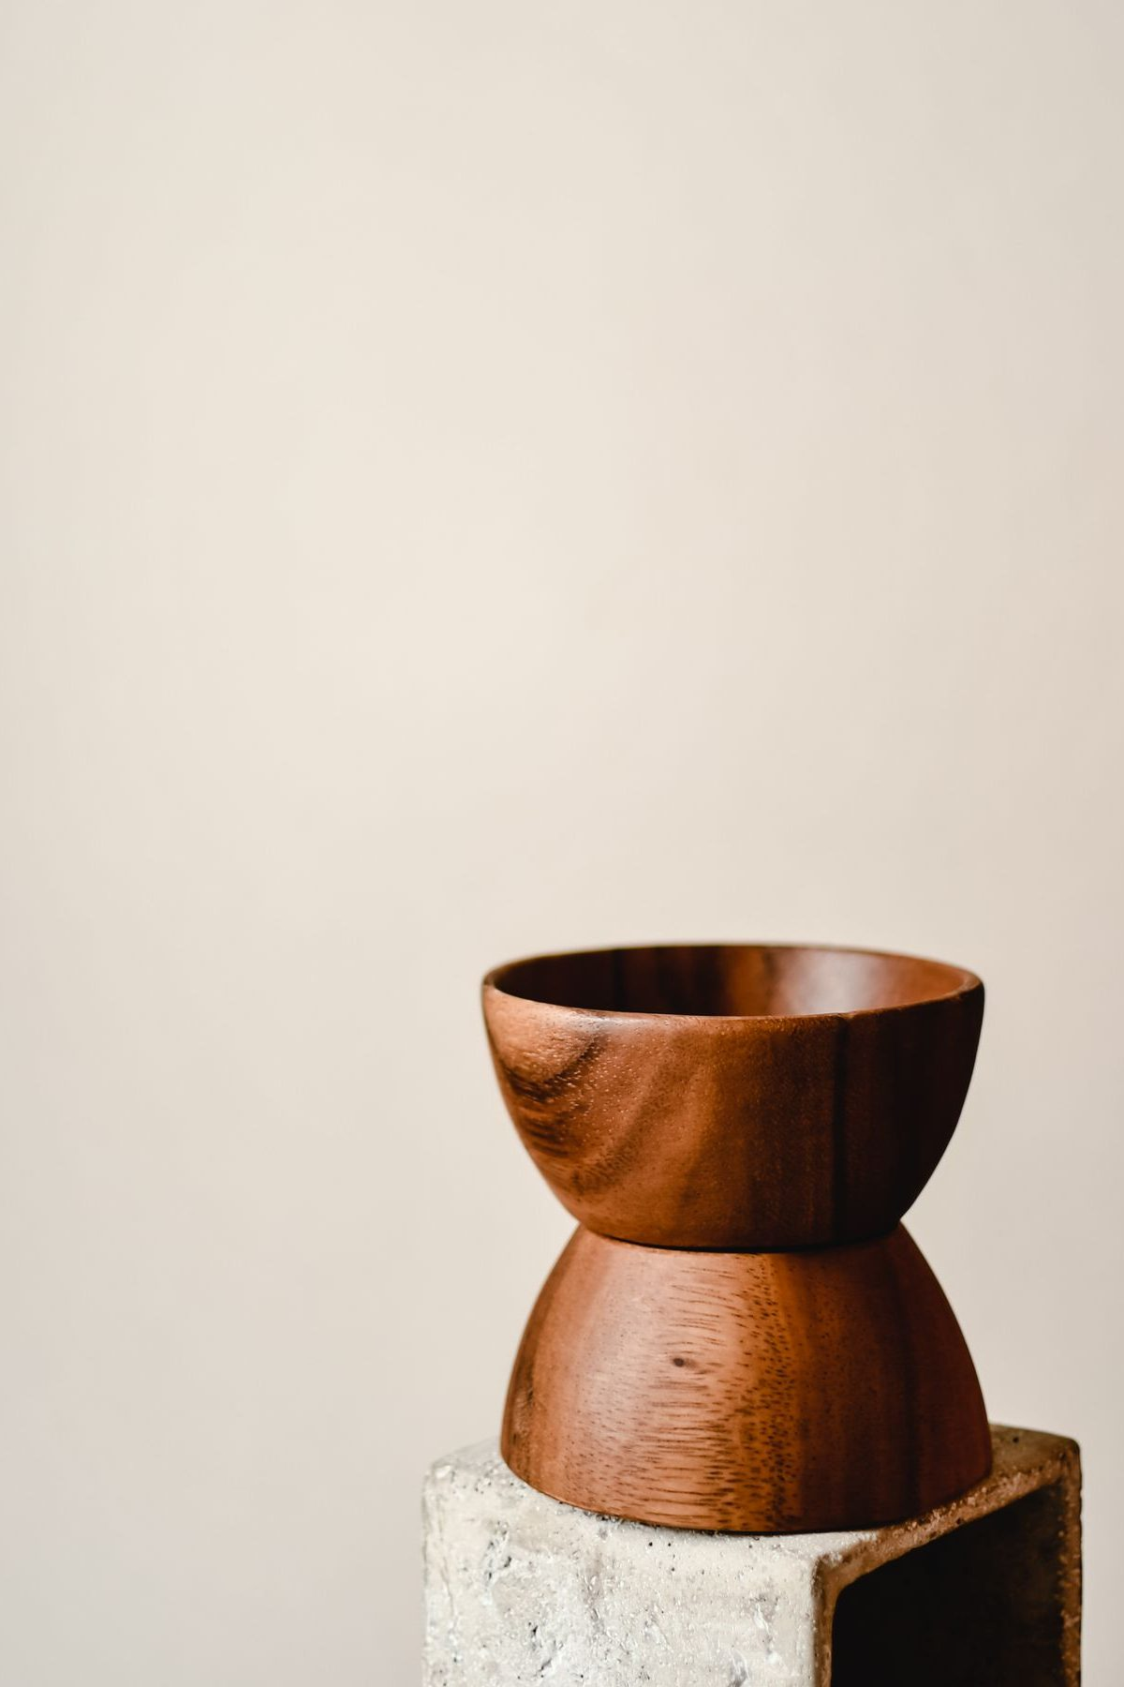
Container Introduction
Safe
– What is shared in this room stays in this room — no judging, no fixing, no interrupting
– No shaming
Present
– Focused here — in this room, with these people
– Phones silent and put away
Clear
– Releasing any roadblocks to hearing — set them aside intentionally
Intentional
– “I’m leaning in. I’m looking for what God has for me in the next seventy-five minutes.”
8
Notes:
S1 · 7:20–7:32 · LEAD: CONTAINER HOLDER
BEATS:
1. Most important block of Session 1 — do not rush it.
2. Name the four conditions once: Safe, Present, Clear, Intentional.
3. Teach the commitment plus the honest alternative: 'I am here, and I am listening' is a full way to stand in the circle, not a lesser one. Nobody tracks who says which.
4. Everyone stands; walk the eight-step opening protocol (Handbook Section 5), holding each step.
CUES: The first one-word check-in is the key moment of Week 1 — if every single person says one word, that is your first win.

Slide 8
Opening Container — the Full Eight Steps
1 Welcome — the unhurried open of the container
2 Phones silenced and put away
3 Stand in a circle
4 One-word check-in — how you actually are, right now
5 Put out / bring in — set something down; bring a blessing in
6 Spoken commitment: “I am here. I am paying attention. I am willing to be moved.”
7 Opening prayer — “Holy Spirit, you are welcome here. Speak. We are listening.”
8 Sit. Begin.
9
Notes:
S1 · 7:20–7:32 · LEAD: CONTAINER HOLDER
1. You have just named the four conditions; now show the architecture. The room experienced these steps as tonight opened without knowing their names — walk the eight so they can see the shape they were just held by.
2. From our next evening on, this protocol opens the room at 7:00 with no explanation; tonight is the one night it gets taught.
3. Keep it warm, not procedural: the steps are how the container forms, not rules about it.

Slide 9
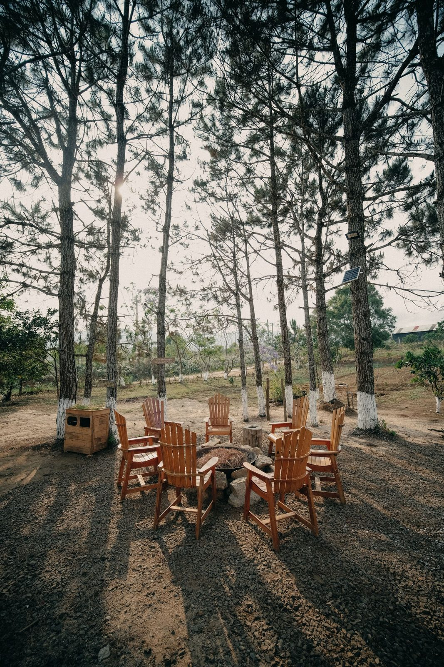
One True Sentence — Why Each of Us Is Here
• Around the circle: one true sentence about why you are here tonight
• One sentence — not a paragraph, not a story
• The word that matters is “true” — not what you think we want to hear
• “Because Mom said I had to be here” counts. “I don’t know yet” counts.
10
Notes:
S1 · 7:32–7:50 · LEAD: CONTAINER HOLDER
BEATS:
1. One true sentence each on why you are here. True beats polished; 'Mom made me come' counts, and so does 'I don't know yet.'
2. You go first — short and true; you set the depth and length.
3. 'I pass today' is allowed; receive with 'Thanks. We're glad you're here' and move on without ceremony.
CUES: The second speaker is a parent, arranged before the session — never a cold call, and never on a teen. Stem for a frozen teen: 'One reason I'm here today is ___.' Two gentle fingers for a parent giving a speech.
GUARD: If something heavy lands ('I'm here because I'm drowning'): 'Thank you for trusting us with that. We will hold that.' Never process it in the circle; follow up after.
SUB: The plan's example sentences are the founder's. Speak your OWN true sentence — pre-write three, pick one in the moment. Never perform someone else's.

Slide 10
Scripture: John 10:10 — and the Seed, Stated Plainly
JOHN 10:10
“The thief comes only to steal and kill and destroy. I came that they may have life and have it abundantly.”
THE QUESTION TO CARRY HOME — NOT TO ANSWER TONIGHT
“Where in my life am I living abundantly, and where am I living some thinner version of life that Jesus did not come to give me?”
11
Notes:
S1 · 7:50–8:00 · LEAD: CONTENT PRESENTER
BEATS:
1. 'Tonight's scripture. Listen for one word.' Read John 10:10 in full from the physical Bible — slowly, once. The screen holds the words; the Bible carries the reading.
2. Abundantly — the word the year hangs on. The thief's purpose against His purpose; the more is real and it cost Him everything (John 10:11). Point to the carry-home question on the slide: not to answer tonight — to carry.
3. Close the Bible. One beat of quiet. The seed, stated plainly (2–3 min) — full script in the plan, Block 6. The year's proclamation: do not rush it; do not decorate it.
ADVANCE CUE: next slide exactly at the seed's last line — 'which raises a question worth sitting with on our very first night —'

Slide 11
What does it mean to be saved?
12
Notes:
S1 · 8:00–8:03 · LEAD: CONTENT PRESENTER
ADVANCE CUE: this slide goes up exactly at the seed's last line — 'which raises a question worth sitting with on our very first night.'
BEATS:
1. 'What does it mean to be saved?' — the room answers first. Parents may start; popcorn, 2–3 minutes.
2. Receive every answer with a nod and a thank-you — no grading; the thief does the correcting (next slide).
GUARD: an honest 'I don't know' counts; no spotlight, ever.

Slide 12
What Does It Mean to Be Saved?
LUKE 23:42–43
“And he said, ‘Jesus, remember me when you come into your kingdom.’ And he said to him, ‘Truly, I say to you, today you will be with me in paradise.’”
ROMANS 10:9–10
“because, if you confess with your mouth that Jesus is Lord and believe in your heart that God raised him from the dead, you will be saved. For with the heart one believes and is justified, and with the mouth one confesses and is saved.”
Saved: the desire to be connected to Christ, acted on by turning to Him.
No baptism. No church attendance. No cleaned-up life. No time left — he had hours. He wanted Jesus, and he turned to Him — and Jesus said yes. Heart and mouth: believe, and say so. Not a certificate. A connection.
13
Notes:
S1 · 8:03–8:10 · LEAD: CONTENT PRESENTER
BEATS:
1. Read Luke 23:39–43 slowly, then show the response: no baptism, no cleaned-up life — desire aimed at Christ, and Christ's yes. Romans 10:9–10: heart and mouth.
2. Land the year's working definition: saved = the desire to be connected to Christ, acted on by turning to Him.
GUARD: No assurance or baptism debates today — 'the thief settles today's question; come find me.' Watch gently for the face that changes; no spotlight, ever.

Slide 13
As Far as the East Is from the West
PSALM 103:12
“as far as the east is from the west, so far does he remove our transgressions from us.”
N
W
E
S
It is all about which way you are pointing. Catch yourself pointing east, and turn.
14
Notes:
S1 — inside the saved discussion, straight after the definition — LEAD: CONTENT PRESENTER. Ask it as a real question: how far is the east from the west? Let two or three answers come. Get the compass out on your phone. Stand in the middle of the circle. "Okay. I am heading east. How far is west from here?" Then bring the room in. They have been sitting since the container opened, so ask for their feet. "Everybody up for a second. Turn and face east with me." Wait for the whole room to come around; let it be slightly awkward, and do not hurry them. "That is east. Now - turn west." Turn with them, slowly, and stop. Let the room stand there facing the other way for a beat before you say anything. "That is it. That is how far west is from east. It is all about which way you are pointing. And no matter when you catch yourself pointing east - no matter how long you have been walking that way - all you have to do is turn around and point west." "That is what the verse means when it says He removes our transgressions as far as the east is from the west. And it is the same word we just used for what saved is: turning." Then stop. Do not explain it further and do not open it for discussion. The turn lands in the body before it lands in the head, which is why the whole room turns rather than watching one person do it. It also gives them a picture for the definition they just heard: saved is the desire to be connected to Christ, acted on by turning to Him. If the compass will not settle indoors, pick a wall during setup and call it east. The demonstration needs the turn to be real, not the needle to be right.

Slide 14
The First Page
If you could ask God one question — and know that He would answer it for you this year — what would you ask Him?
• Open your journal to the very first page — write it in your own handwriting
• The question you actually have — not the one you’re supposed to have
• Date it. Nobody will ever read it — the journal is yours, never collected
• This room will come back to that page before the year is done
Two quiet minutes, no music. Companions write their own first page too.
15
Notes:
S1 · 8:10–8:14 · LEAD: CONTENT PRESENTER
BEATS:
1. Tail of the saved block. Notebooks open to the very first blank page.
2. The question: if you could ask God one question and know He would answer it this year, what would you ask? The real one, not the supposed-to one. Date it.
3. Two silent minutes — no music, no commentary. Companions write their own first page too, visibly.
GUARD: Nobody will ever read it; the journal is never collected. Say so — the privacy is the point, and the room comes back to this page before the year ends.

Slide 15

Homework — Two Weeks, Four Parts
• Week one — the simplest practice we will give you in all of Getting Started
• Each morning, before the phone: five quiet minutes
– Ask one question: “Father, what are you up to today, and what do you want me to notice?”
– Then sit. Listen. The asking is the practice.
• Each evening, sixty seconds: one specific sentence in the journal — what did I notice today?
• End of week one: report to your check-in partner. Week two: add John 10:10 — where is abundance, and where isn’t it? Parents are doing this too — we check in when we gather
16
Notes:
S1 · 8:20–8:24 · LEAD: CONTENT PRESENTER
BEATS:
1. Week one of two: the two questions, morning and evening. Each morning, before the phone: five minutes — 'Father, what are You up to today, and what do You want me to notice?' Then sit. The asking is the practice.
2. Evening: one specific sentence in the journal — what did I notice today?
3. 'Parents, you are doing this too. We'll check in next week.'
CUES: The Parent Co-Companion leads this block, not you — parents need to hear from a parent that they are doing it too.

Slide 16
Homework, If You Want It — Five Questions for Your Journal
These are the five questions we ask every family on the way into this work — some of you have met them already; some are meeting them tonight. They’re printed in your journal handout. If you want more than the one practice this week: give each one a page.
1 What do you sense the Spirit might be doing in you right now?
2 What’s drawing you toward something like this?
3 What are you a little afraid of?
4 What would you NOT want this to be?
5 Where would you say you are with Jesus — has there been a time you said yes to Him, or is that still an open question?
Your journal is never collected and never read. A page per question or a single sentence — whatever is true.
17
Notes:
S1 · 8:20–8:24 · LEAD: CONTENT PRESENTER
BEATS:
1. Thirty seconds, as the first-page pens settle. 'On the way into this work we ask every family five questions — some of you met them in a conversation with one of us; some of you are meeting them right now, and that is just as good a door. They're printed in your journal, right after the where-am-I-with-Jesus page. A page per question this week, or a single sentence — if you want more than the one practice.'
2. Say the privacy line again, even though they know it: the journal is never collected, never read; nobody will ever ask what you wrote.
GUARD: an offer, never an assignment — the week's only ask is the morning question (next slide). If the evening is running long, skip this slide without loss; the questions are in the journal either way.

Slide 17
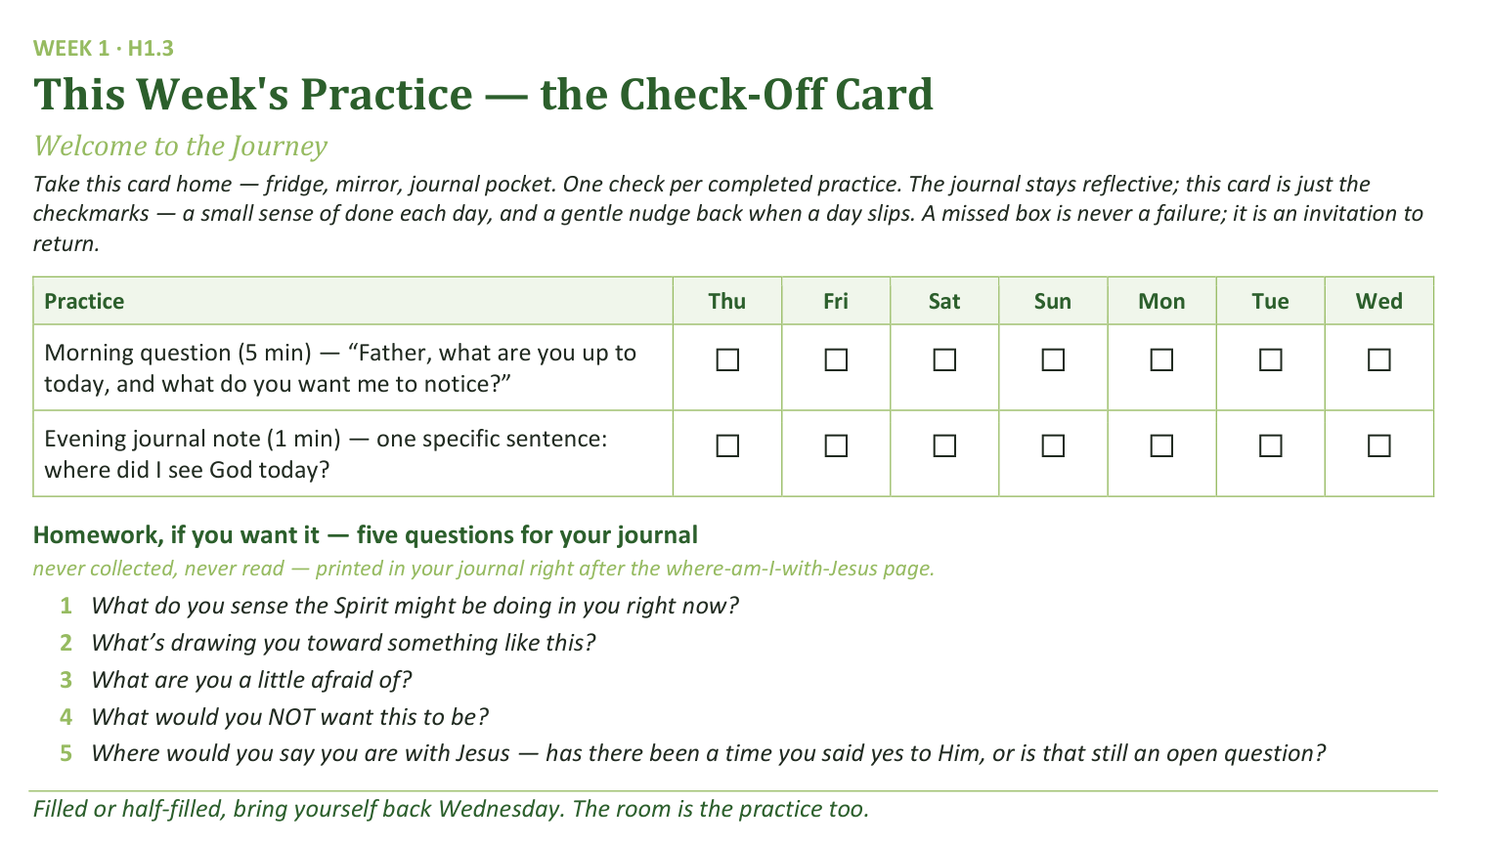
Your Take-Home Card — This Session’s Practice
Handed out now — fridge, mirror, notebook pocket. Two weeks, four boxes:
☐ Week one — the two questions, morning and evening
☐ End of week one — report to your check-in partner
☐ Week two — keep both questions, add the abundance question
☐ One sentence of prep before we gather
18
Notes:
S1 · 8:20–8:24 · LEAD: CONTENT PRESENTER
BEATS:
1. Hold up the check-off card (H1.3) — fridge, mirror, or journal pocket; one check per completed practice.
2. Say the card's grace note aloud: a missed box is never a failure; it is an invitation to return.
CUES: Rides inside the practice block — keep the two slides to four minutes together.

Slide 18
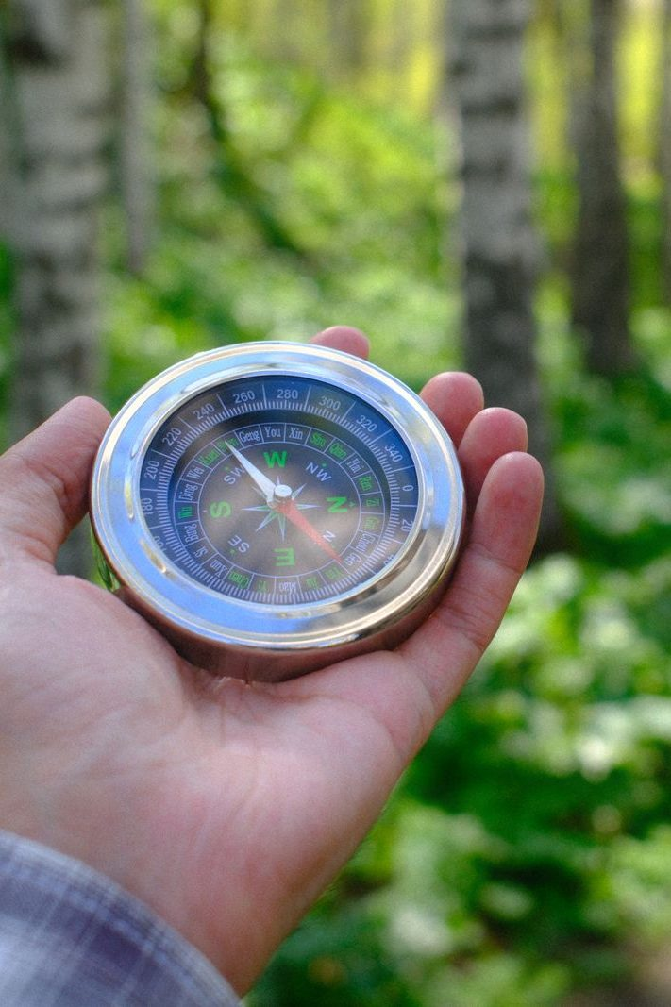
The Leader Feedback Round
• Two rounds, same as every session from here on — the container holder first, then the content presenter: three things each
– “What I think went well tonight: ______”
– “What I’d do differently next time: ______”
– “If I were to teach tonight’s process to someone, I would tell them: ______”
• Then the room — the same two questions about tonight
• The leaders receive without defending — “thank you” is the whole response
19
Notes:
S1 · 8:24–8:28 · LEAD: BOTH LEADERS
BEATS:
1. Debut today. Two rounds: the container holder first, then the content presenter. Three things: what went well; what I'd do differently; what I'd tell someone teaching today's process.
2. Then the room, same two questions; two or three voices is plenty.
3. Receive without defending — 'thank you' is the whole response.
CUES: Week 1 order: the closing container runs at 5:18 BEFORE this round; the blessing follows it at 5:27. May be dropped if the room needs something else; twice running goes to the team debrief.

Slide 19
Closing the Container + Aaronic Blessing
• We close the way we opened — the container, six steps:
1 Stand again — same circle, same posture as the open
2 One-word landing — compare it to your opening word
3 The one thing you are taking from tonight
4 The one practice — said together: “Father, what are you up to today, and what do you want me to notice?”
5 Blessings — specific, witnessed, short
6 Closing prayer — then the Aaronic blessing, spoken over each other, face to face
THE AARONIC BLESSING — NUMBERS 6:24–26
“The Lord bless you and keep you;
the Lord make his face to shine upon you, and be gracious to you;
the Lord lift up his countenance upon you, and give you peace.”
20
Notes:
S1 · 8:28–8:30 · LEAD: CONTAINER HOLDER
BEATS:
1. Six-step closing (Handbook Section 5). One-word landing — any word, even 'tired'; do not push for depth today.
2. The one practice, said aloud together: 'Father, what are You up to today, and what do You want me to notice?'
3. Blessings: do not press in Week 1; honor any offered. Closing prayer 30 seconds, naming the Holy Spirit.
4. Aaronic blessing at 5:27: teens face parents, hand on shoulder if comfortable; read the card together, slowly. Pause. 'Take your blessing card with you.'
CUES: Week 1 order: closing 5:18, Leader Feedback Round 5:24, blessing 5:27 — the round sits inside this window.

